Slide 1

Rami Wail, Ahmed Alaa, Mohamed Hatem
201600112 - 201600352-201600075
DG - FinFet: Project Presentation 2
Supervised by : Dr Amr Bayoumi.
Naneng 520

Slide 2
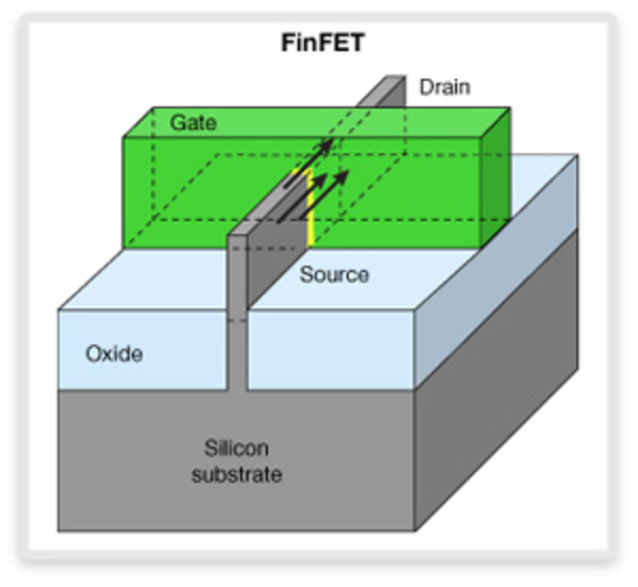
Introduction
FinFET(Fin Field Effect Transistor) named fin because the source /drain region form a fin on the silicon surface
prefered gate design in CMOS from 14 nm to 7 nm due to its many superior attributes.

Slide 3
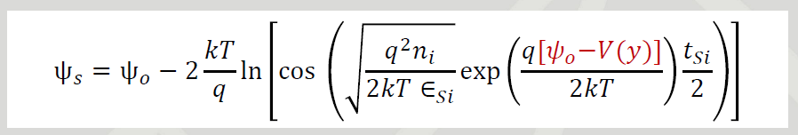
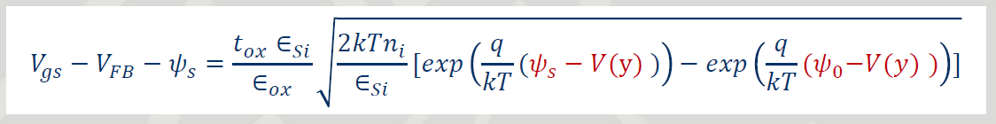

Slide 4
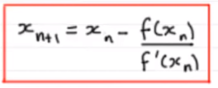
Damped newton raphson method

Slide 5
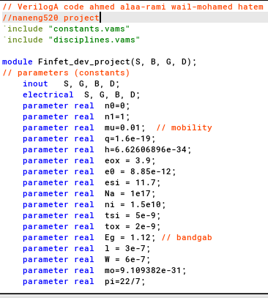
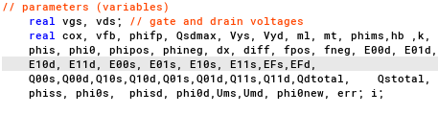
Verilog A - Parameters

Slide 6
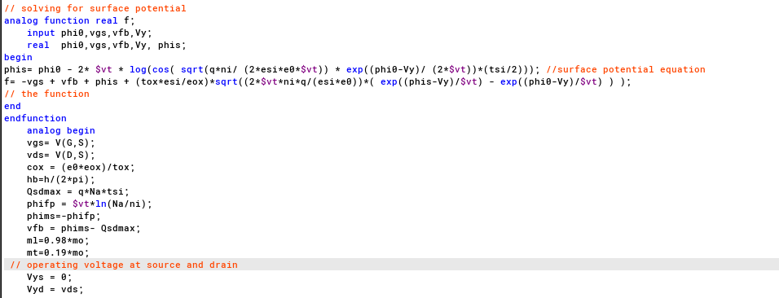
Verilog A

Slide 7
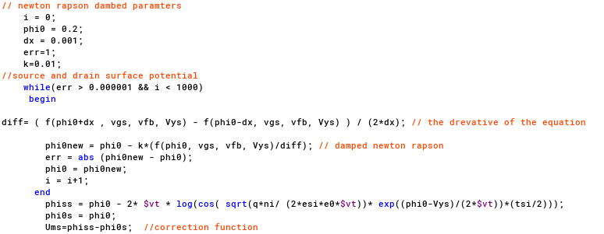
Verilog A

Slide 8
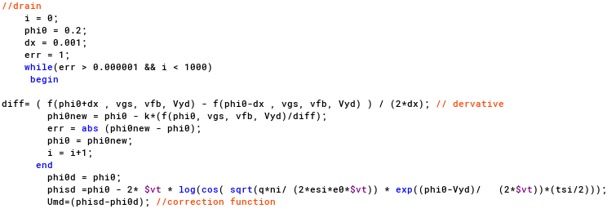
Verilog A

Slide 9
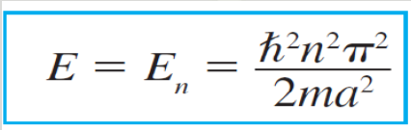
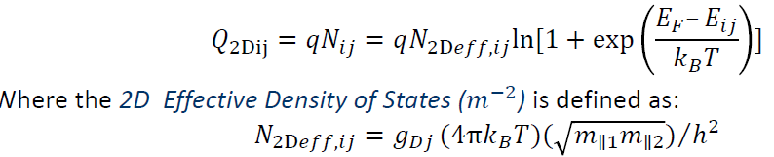
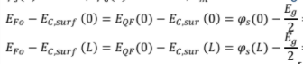
Quantum equations

Slide 10
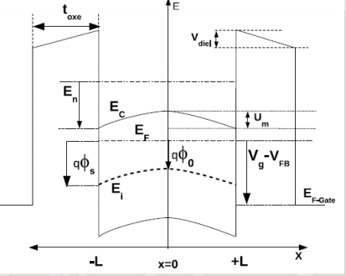
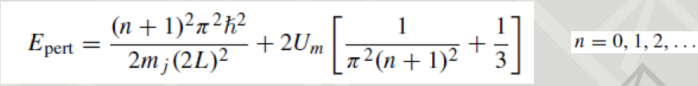

Slide 11
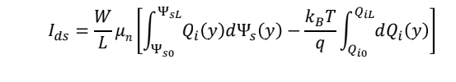
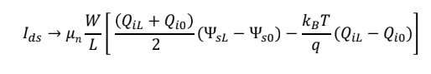
Current equation

Slide 12
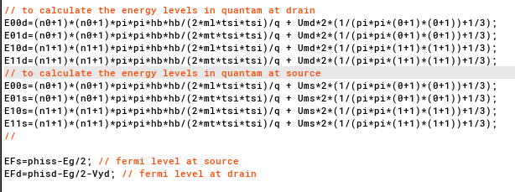
Verilog A

Slide 13
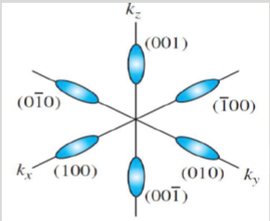
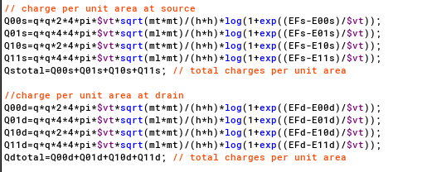
Verilog A

Slide 14
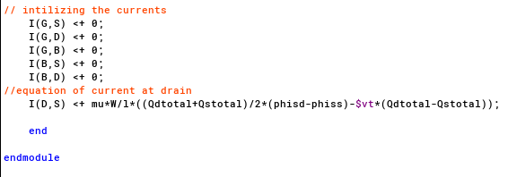
Verilog A

Slide 15
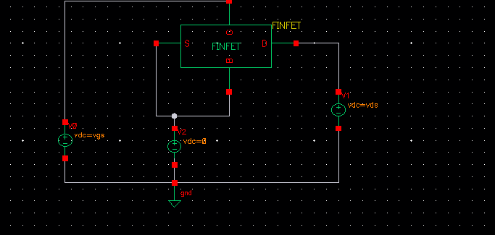
Testing circuit

Slide 16
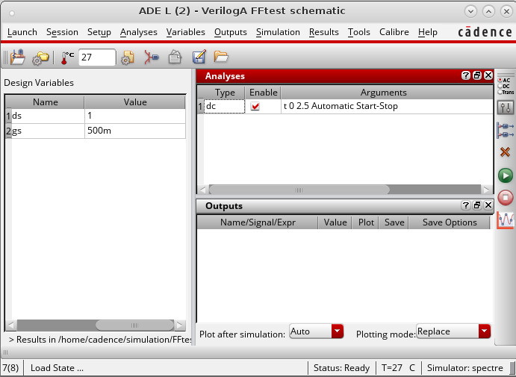
Simulation

Slide 17
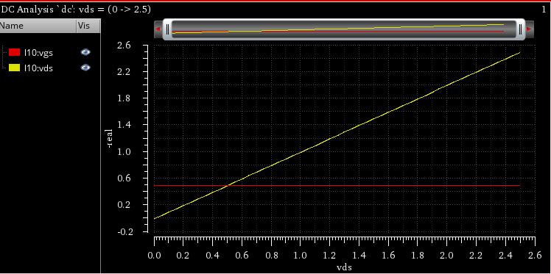
Results -voltage

Slide 18
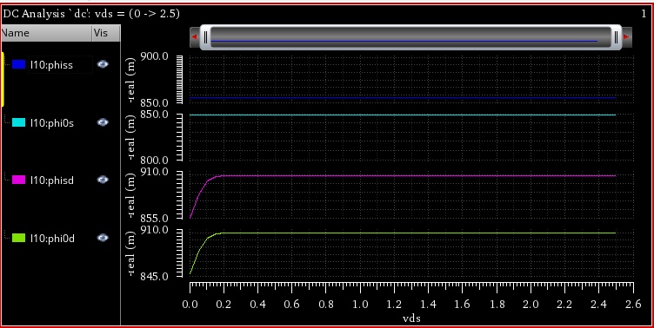
Surface potential

Slide 19
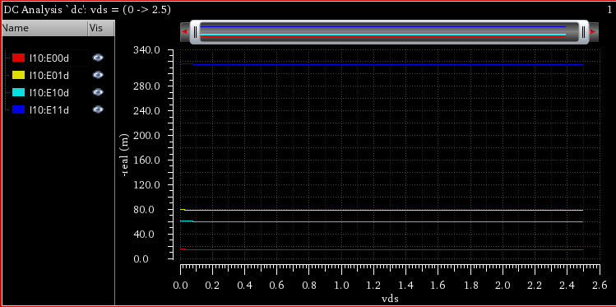
Energy levels at drain

Slide 20
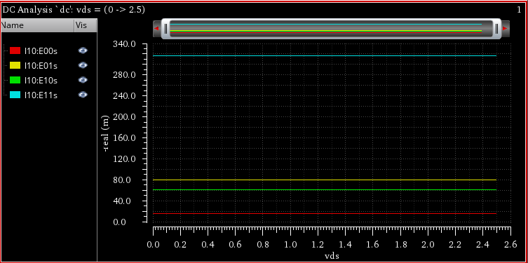
Energy levels at source

Slide 21
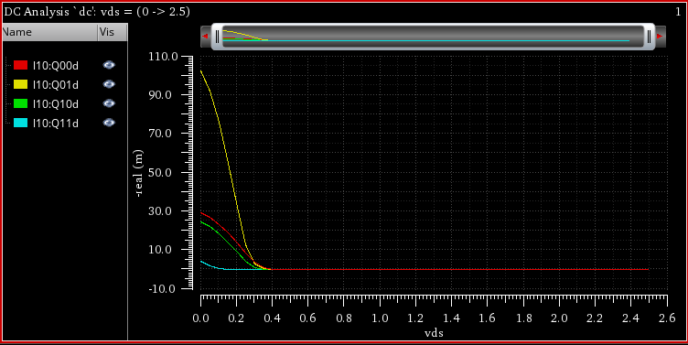
Charge per unit area drain

Slide 22
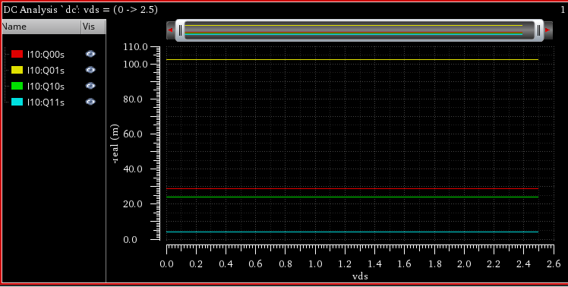
Charge per unit area source

Slide 23
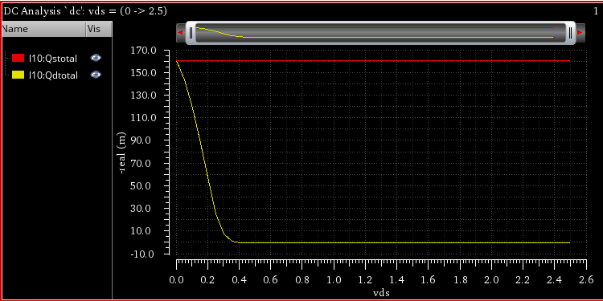

Slide 24
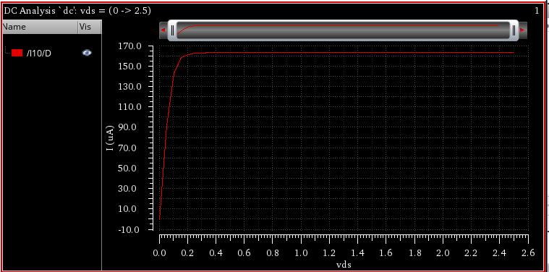
Current at drain

Slide 25
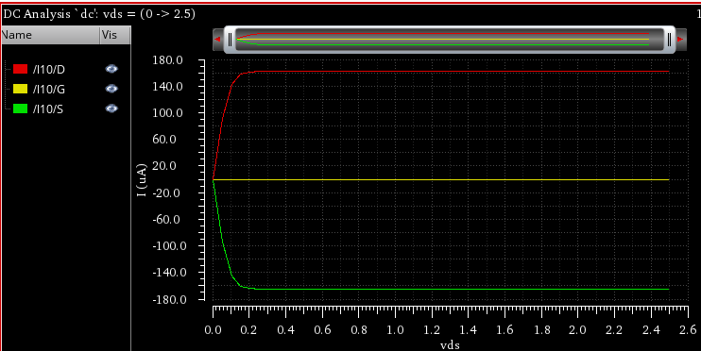
currents

Slide 26
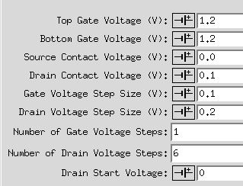
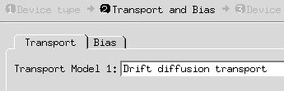
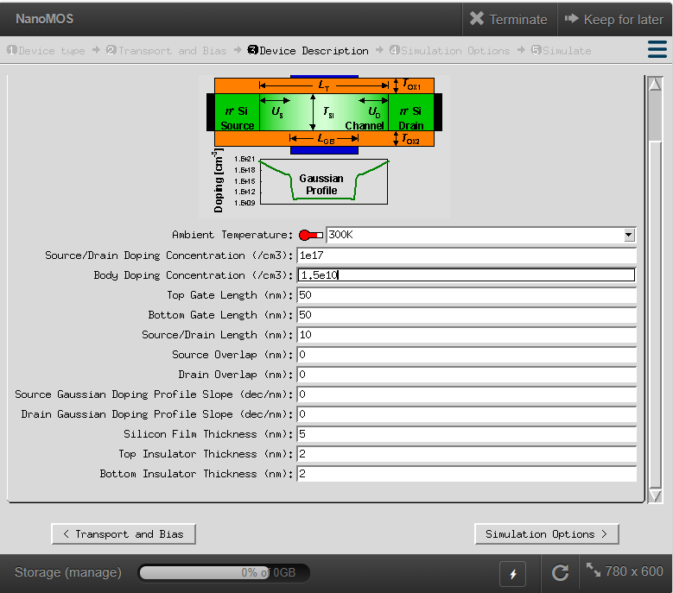
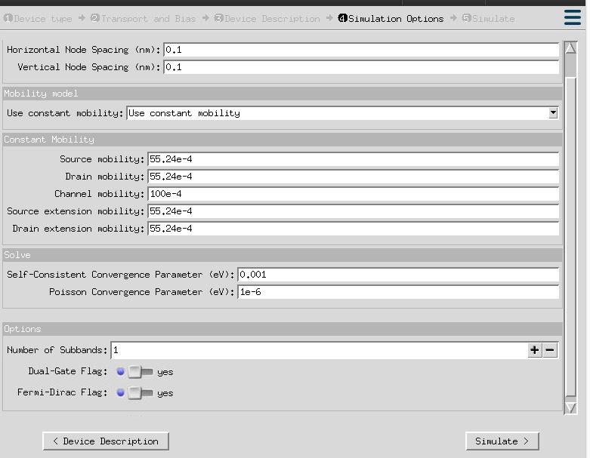
Nanohub tool

Slide 27
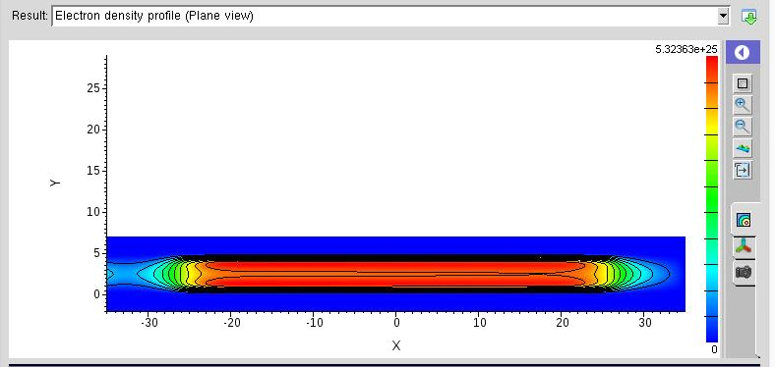
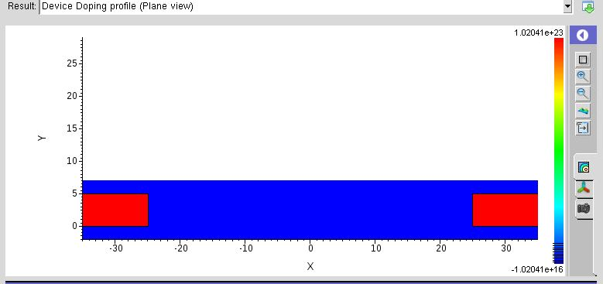
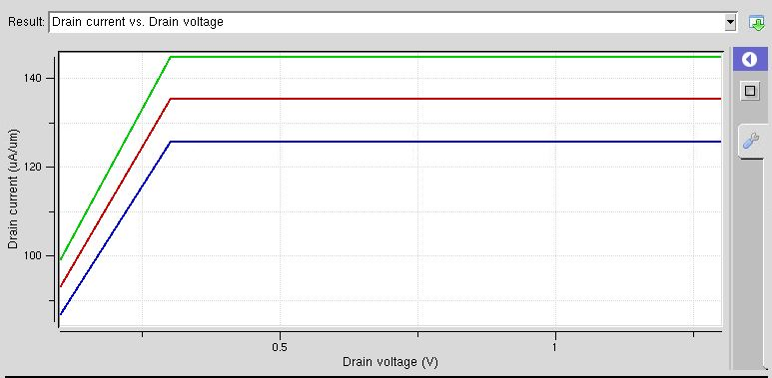
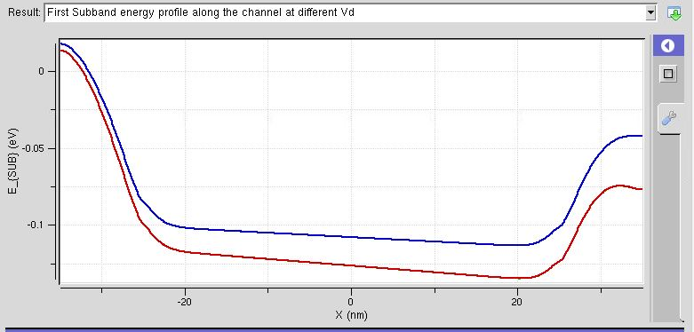
Nanohub simulation

Slide 28
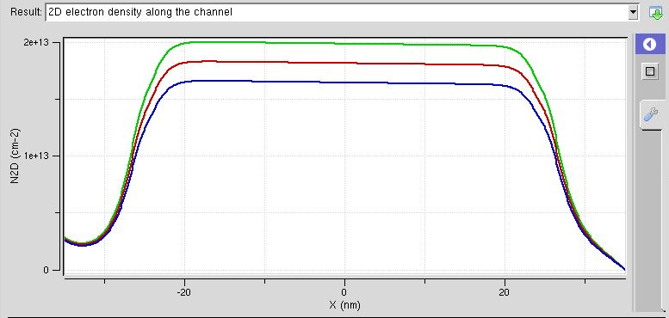
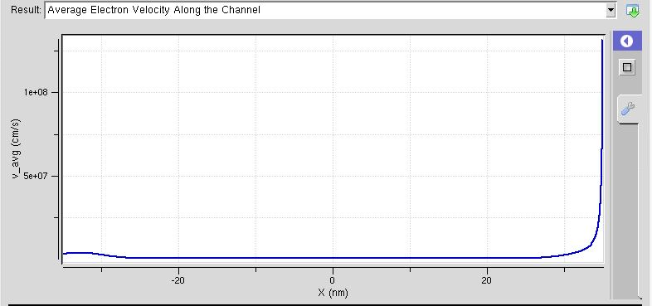
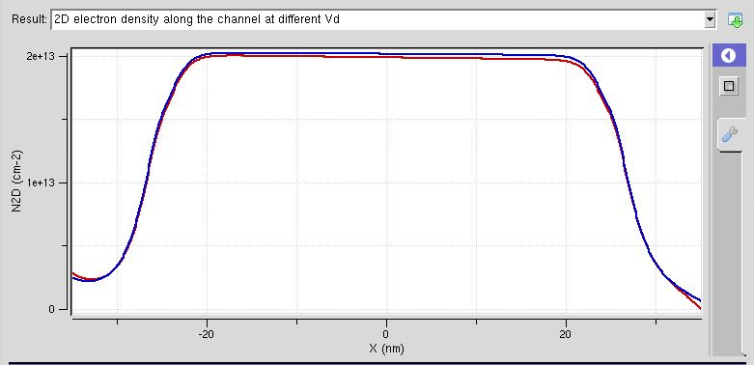
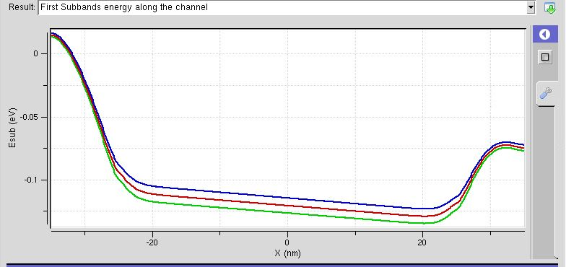
Nanohub simulation

Slide 29
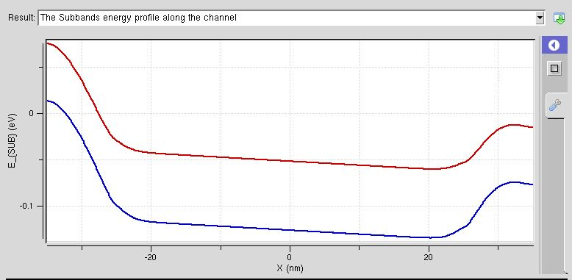
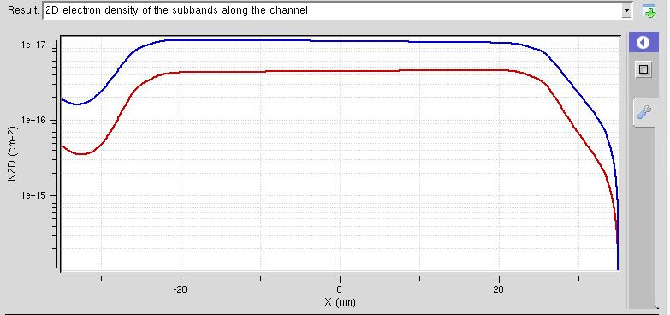
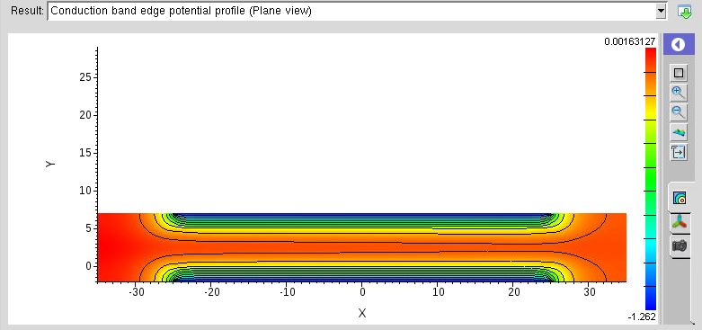
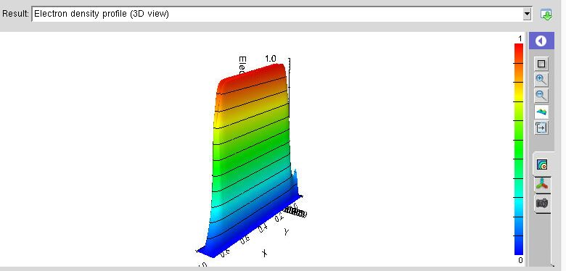
Nanohub simulation

Slide 30
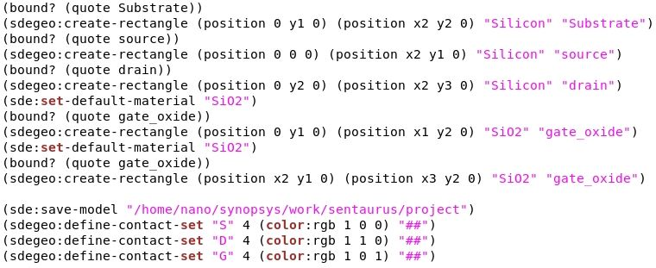
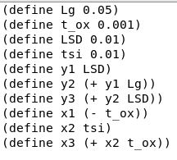
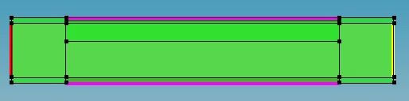
Sentaurus sde

Slide 31


Sentaurus sde

Slide 32





Sentaurus sdevice

Slide 33
Tasks Partitioning
Task | Rami | Ahmed | Mohamed
Verilog A | Quantum equations and calculations: Discrete energy levels Charge per unit area Effective density of states Energy levels with correction Drain Current | Newton raphson solution: vgs, vds Phi_fp, Phi_ms NR damped Source and Drain potential Diff, correction Test circuit | Classical equations & Parameters: finfet module Parameters (constants) Parameters (variables) Surface potential
Sentaurus sde | Geometry and profile: Definitions Parameters Locations | Parameters and contacts: Contact initialization and colouring Set contact edges | Doping and meshing: Define profiles Refinement size and placement
Sentaurus sdevice | File, electrode, physics | Plot | Math, solve

Slide 34
Thank you

